Slide 1

Capstone project
Exploratory Data Analysis(EDA)
on
Hotel Booking
by
Debiprasad Samal (Self)

Slide 2






Instruments used :
Python
Matplotlib
Pandas
Seaborn
Numpy

Slide 3



Interesting facts about hotel :
A hotel is an establishment that provides lodging, meals and other services for travellers paying guests .
The word hotel is derived from the French hôtel (coming from the same origin as hospital) .
Guinness World Records officially recognised Japan's Nishiyama Onsen Keiunkan, founded in 705, as the oldest hotel in the world .
In 2006, Guinness World Records listed the First World Hotel in Genting Highlands, Malaysia, as the world's largest hotel with a total of 6,118 rooms .
The Rosewood Guangzhou located on the top floors of the 108-story Guangzhou CTF Finance Centre in Tianhe District, Guangzhou, China. Soaring to 530-meters at it’s highest point, earns the singular status as the world's highest hotel.

Slide 4

Work flow of EDA :
Data collection & understanding
Data Wrangling
Visualisation & Analysis of Data
Conclusion

Slide 5

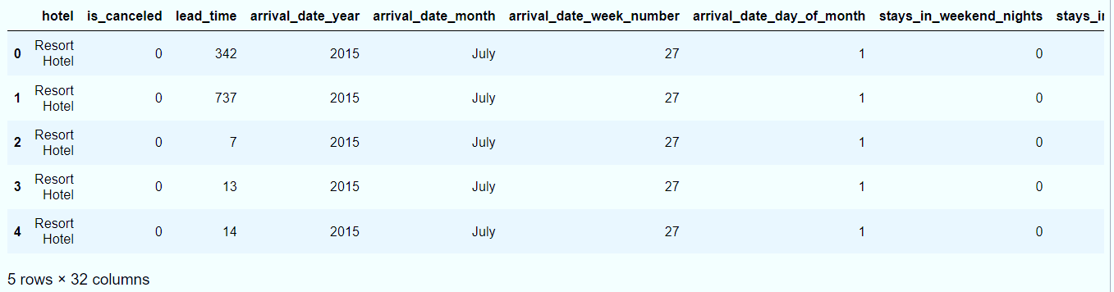

Data collection and understanding :
Imported all the libraries.
I saved the path of the file ‘Hotel Bookings.csv’ as path .
Then read the csv file by using pandas.read_csv(path) function.
First 5 rows :

Slide 6
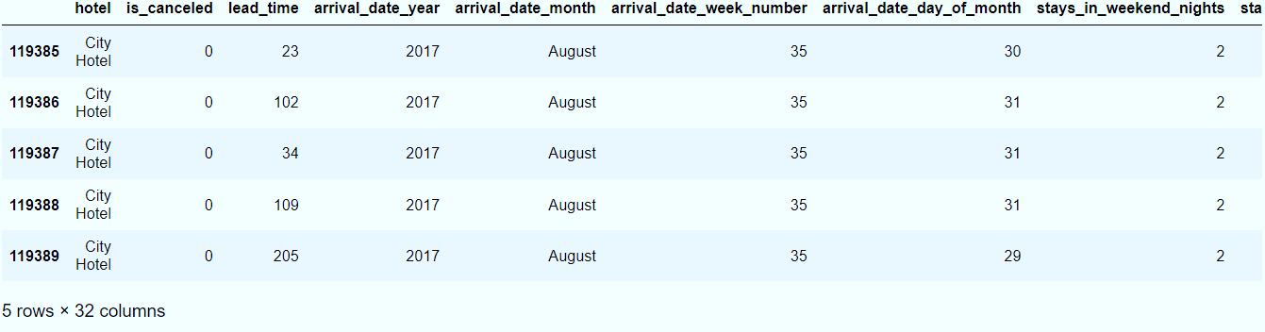
Last 5 rows :
Column names :
['hotel', 'is_canceled', 'lead_time', 'arrival_date_year','arrival_date_month', 'arrival_date_week_number','arrival_date_day_of_month', 'stays_in_weekend_nights','stays_in_week_nights', 'adults', 'children', 'babies', 'meal','country', 'market_segment', 'distribution_channel','is_repeated_guest', 'previous_cancellations','previous_bookings_not_canceled', 'reserved_room_type','assigned_room_type', 'booking_changes', 'deposit_type', 'agent','company', 'days_in_waiting_list', 'customer_type', 'adr','required_car_parking_spaces', 'total_of_special_requests','reservation_status', 'reservation_status_date']

Slide 7
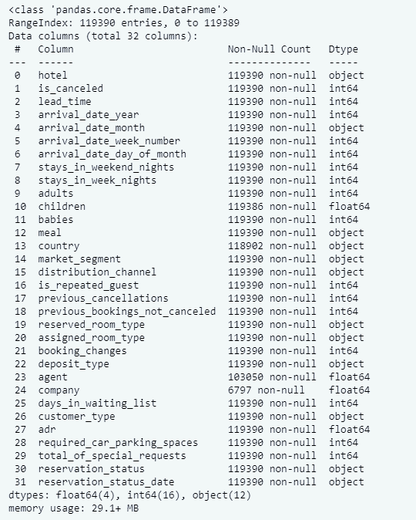
Information of the data :

Slide 8
Let’s understand the columns :
hotel : Hotel(Resort Hotel or City Hotel)
is_canceled : Value indicating if the booking was canceled (1) or not (0)
lead_time : Number of days that elapsed between the entering date of the booking into the PMS and the arrival date
arrival_date_year : Year of arrival date
arrival_date_month : Month of arrival date
arrival_date_week_number : Week number of year for arrival date
arrival_date_day_of_month : Day of arrival date
stays_in_weekend_nights : Number of weekend nights (Saturday or Sunday) the guest stayed or booked to stay at the hotel
stays_in_week_nights : Number of week nights (Monday to Friday) the guest stayed or booked to stay at the hotel.

Slide 9
adults : Number of adults
children : Number of children
babies : Number of babies
meal : Type of meal booked. Categories are presented in standard hospitality meal packages
country : Country of origin
market_segment : Market segment designation. In categories, the term “TA” means “Travel Agents” and “TO” means “Tour Operators”
distribution_channel : Booking distribution channel. The term “TA” means “Travel Agents” and “TO” means “Tour Operators”
is_repeated_guest : Value indicating if the booking name was from a repeated guest (1) or not (0)
previous_cancellations : Number of previous bookings that were cancelled by the customer prior to the current booking.
booking_changes : Number of changes/amendments made to the booking from the moment the booking was entered on the PMS until the moment of check-in or cancellation
deposit_type : Indication on if the customer made a deposit to guarantee the booking.

Slide 10
agent : ID of the travel agency that made the booking
company : ID of the company/entity that made the booking or responsible for paying the booking.
days_in_waiting_list : Number of days the booking was in the waiting list before it was confirmed to the customer
customer_type : Type of booking, assuming one of four categories
adr : Average Daily Rate as defined by dividing the sum of all lodging transactions by the total number of staying nights
required_car_parking_spaces : Number of car parking spaces required by the customer
previous_bookings_not_canceled : Number of previous bookings not cancelled by the customer prior to the current booking
reserved_room_type : Code of room type reserved. Code is presented instead of designation for anonymity reasons.
assigned_room_type : Code for the type of room assigned to the booking.
required_car_parking_spaces : Number of car parking spaces required by the customer
total_of_special_requests : Number of special requests made by the customer

Slide 11
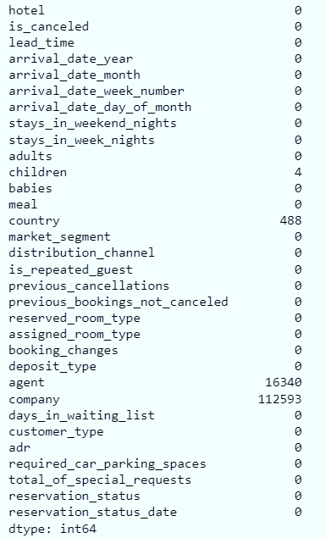
Data wrangling :
Filling null values :
Null values :

Slide 12
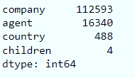
Columns with null values :
Percentage of null values of the columns :
company = 94.3%
agent = 13.6%
country = 0.4%
children = .0003%
As column ‘company’ has more than 90% of null values, I dropped the column.
Replaced the null values in ‘agent’ and ‘children’ column with 0(zero) and ‘country’ column with ‘other’.
I combined ‘children’ and ‘babies’ column and created a new column as ‘toddler’ . Then dropped both the previous columns .

Slide 13
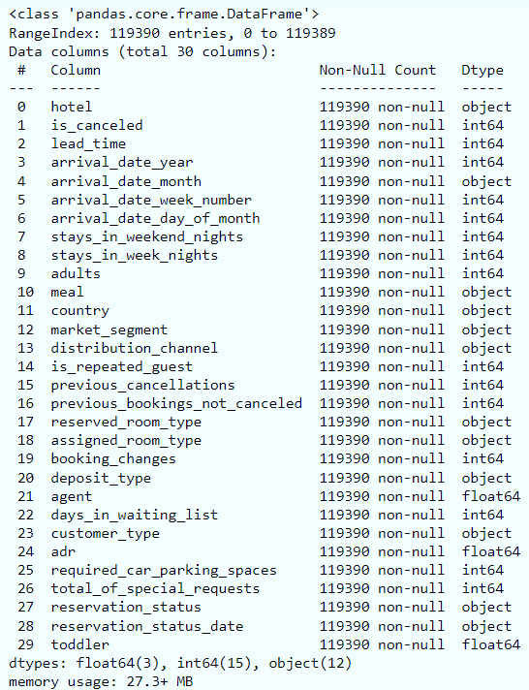
After filling null values, data.info( ) :

Slide 14
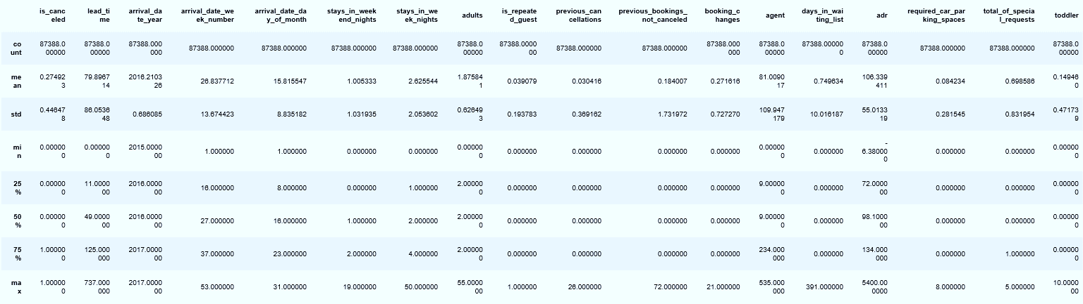
There were 31994 duplicate rows, I dropped them.
Let’s see the numerical descriptions of the data :

Slide 15
Dropped the rows(3 rows) with toddler more than 3(i.e. : 9,10) .
Dropped the rows with 0(zero) adults.
Converted datatype of columns ‘agent’ and 'toddler' from float to int.
Changed datatype of column 'reservation_status_date’ from object to date_type.
Lets first find the correlation between the numerical data.
Since, columns like 'is_cancelled', 'arrival_date_year', 'arrival_date_week_number', 'arrival_date_day_of_month', 'is_repeated_guest', 'company', 'agent' are categorical data having numerical type. So we wont need to check them for correlation.
We are going to take {'lead_time','stays_in_weekend_nights','stays_in_week_nights','adults','previous_cancellations','previous_bookings_not_canceled','booking_changes','days_in_waiting_list','adr','required_car_parking_spaces','total_of_special_requests','toddler’} columns into consideration.

Slide 16

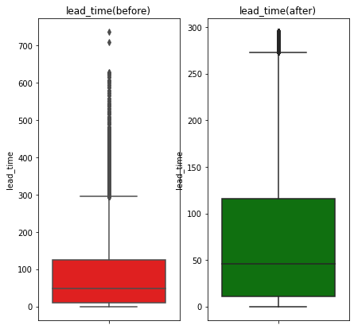
Visualisation & analysis of data ::
Removed outliers from lead_time :

Slide 17
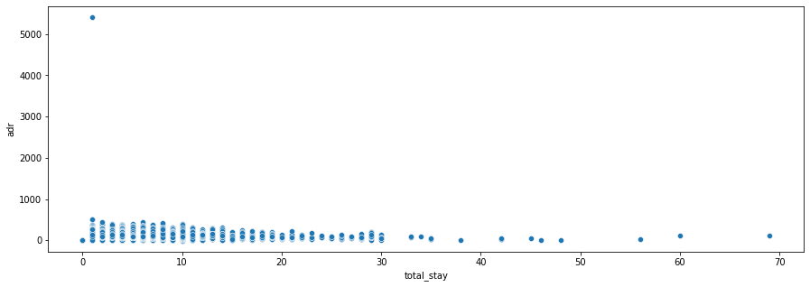
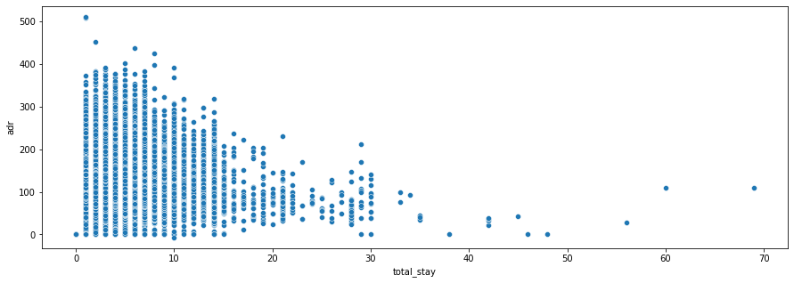
Scatter plot of adr vs total stay :
After removal of outliers :

Slide 18
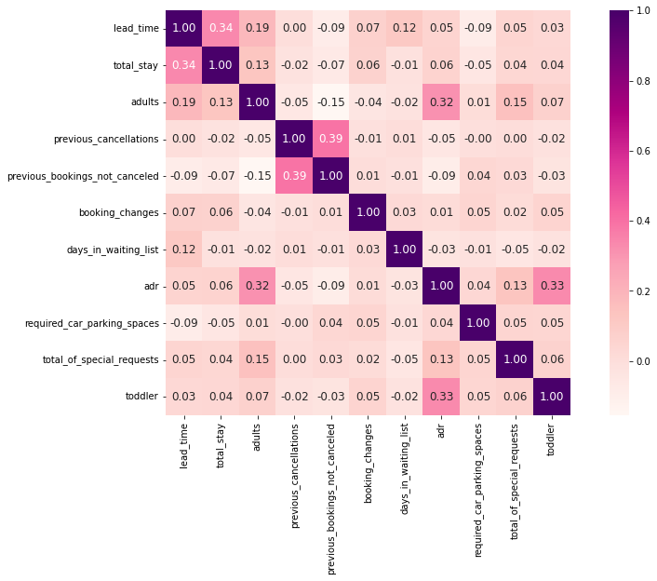
Heat map :

Slide 19
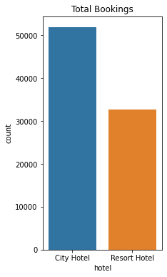
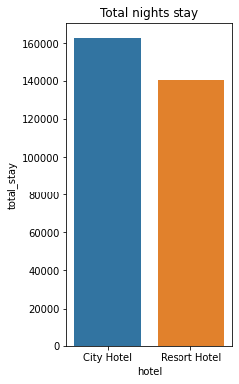
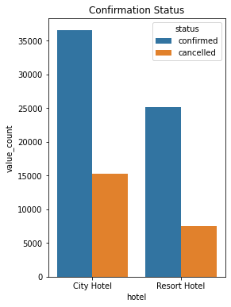
Comparing total nights spent and confirmed vs cancelled in both the types of hotels :

Slide 20
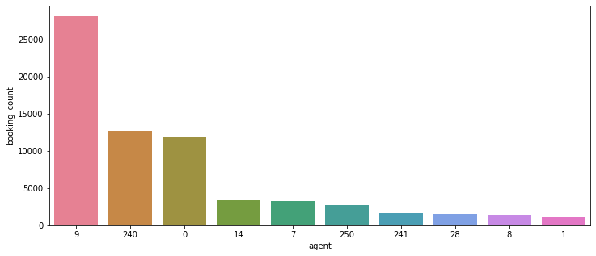
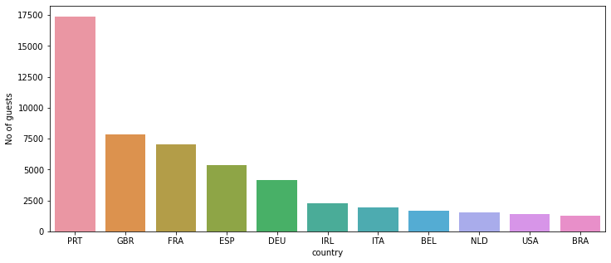
Checked the top 10 agents according to number of bookings :
Checked the top 10 countries with respect to number of guests :

Slide 21
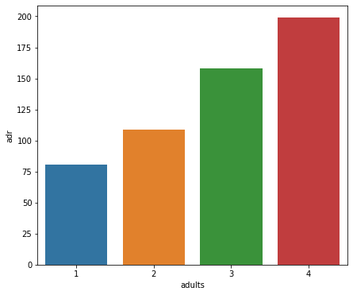
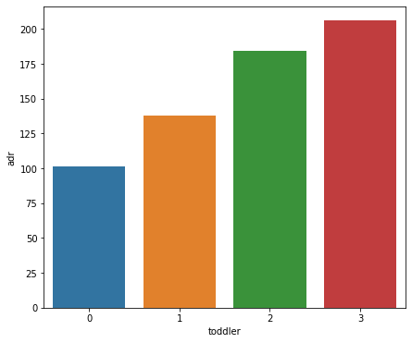
Comparison of adr with respect to number of adults and toddler:

Slide 22
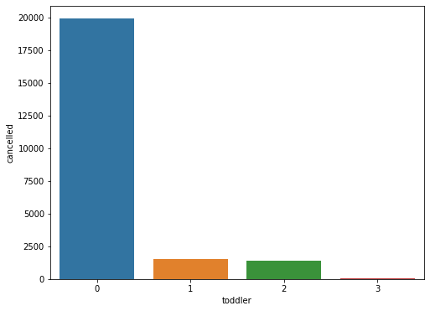
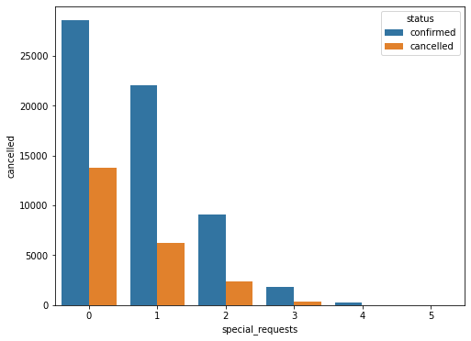
Now let’s check the number of cancellation vs number of toddler :
Status(cancelled/confirmed) of hotel with respect to number of special requests :

Slide 23
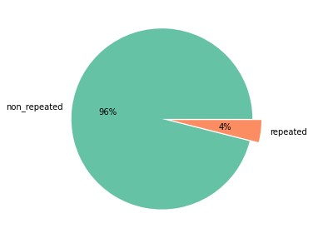
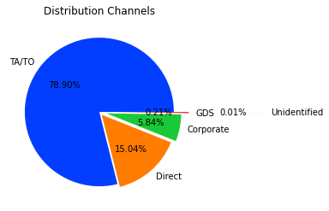
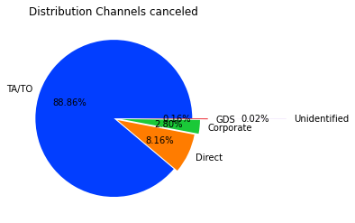
Checked the repeated-customer vs new-customer :
Percentage(%) of booking vs cancelled on types of distribution channels :

Slide 24
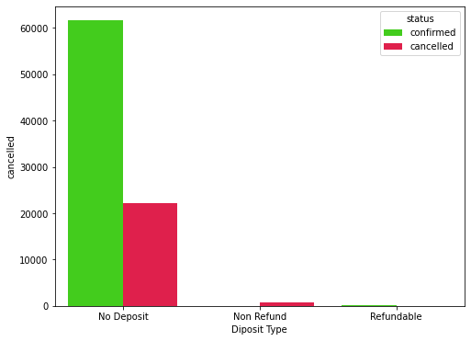
Effect of deposit type on cancellation :

Slide 25
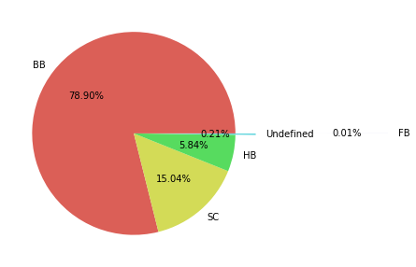
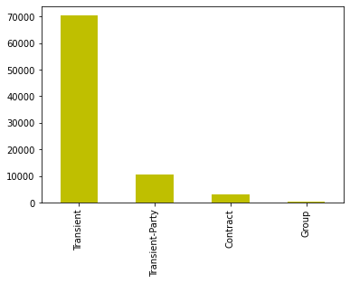
Types of food:
Types of customers :

Slide 26
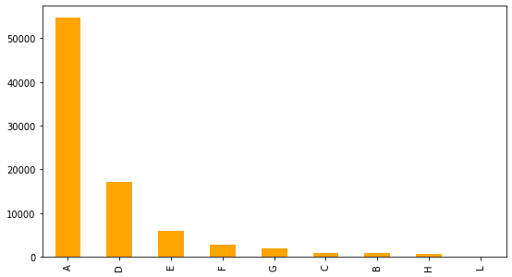
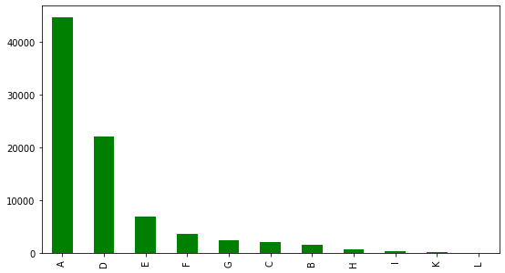
Types of rooms reserved :
Type of room allotted :

Slide 27
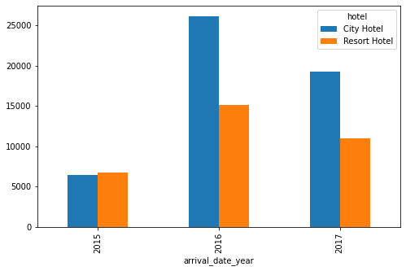
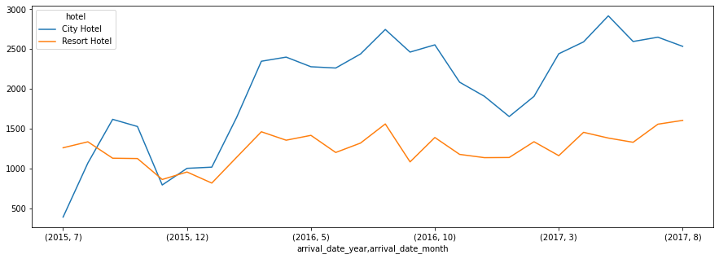
Comparison of bookings of both the type of hotels according to years :
Comparison of bookings of both the type of hotels every month :

Slide 28
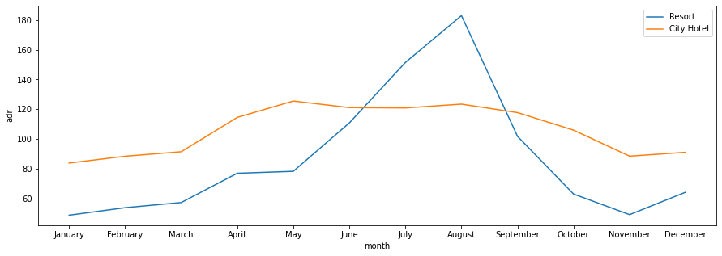
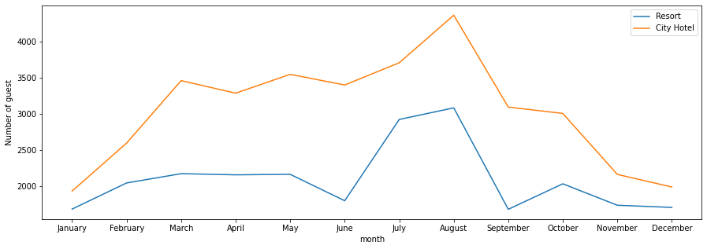
Adr of both the hotels in every month:
Busiest month of the Year:

Slide 29

Conclusion :
From Co-relation Heatmap (P - 18) :
The lead time and total stay slightly related. This means for longer hotel stay people generally plan little before the actual arrival.
adr is slightly correlated with adults as well as toddlers, which makes sense is more number of people means more service to deliver therefore more adr.
Comparison of both the type of hotels(P – 19) :
From the first figure we can clearly see that the City Hotel has a booking more than 50,000, which is around more than 60%; where as the resort hotel has booking more than 30,000 which is around 40% of total bookings.
The second figure shows us that the total night spent in City Hotel is more than 1,60,000 which is around 53%; where as the total night spend in resort hotel is around 1,40,000 which is around 47%.
The 3rd figure shows us that cancellations of CityHotel is higher than cancellations of Resort Hotel when compared to the number of confirmations.
Hence we can conclude that although number of bookings in Resort hotels is lesser than City hotel; but the cancellation rate is also less and people prefer to stay longer there.

Slide 30
From top 10 agents plot (P – 20) :
Agent no. 9 is doing a phenomenal job, as the number of bookings of this agent is not only the highest but also around twice of the second highest agent no. 240.
From top 10 countries with highest number of guests plot (P – 20) :
We can clearly see, PRT stands for Portugal is an easy winner with number of guests around 17000, where as GBR or Great Britain with around 7500 guests comes second and FRA or France comes third with around 7000 guests.
Comparison of adr with respect to number of adults and toddler plot (P – 21) :
Although there are not much co –relation between adr and number of adults or toddler ; but we can clearly see the increase in number of adult or toddler the adr also increases.
Impact of toddler/children on cancellation (P – 22) :
Here it is clear that the cancellation is very hight in case of zero kids as compared to booking with kids. And with the increase in number of kids the rate of cancellation decreases, which is kind of obvious. Because couple with children plan much earlier and better for the security of their child than the couple with no child.
Status of booking with respect to special requests (P – 22) :
Here we can see with the increase in number of special requests, the rate of cancellation decreased. As with zero(0) special requests there were around 30% cancellations where as it decreased to less than 20% with single(1) special request.

Slide 31
From customer repetition plot (P – 23) :
Here we can se around 96% customers are new. As customer retention is an important part of ideal business, the 4 percentage of repeated customers is not a good symbol. But on the other hand the higher the new customer the higher rate of growth can be seen.
It is very important to maintain a equilibrium between rate of increase in new customers and rate of repeating customers. Therefore personalized services, discounts and other special treatments should be served so that the customer will be loyal and these hotels will be their first preference.
Impact of distribution channels on cancellation (P – 23) :
From the two pie plots we can conclude that cancellation percentage decreased to almost half as compared to percentage of bookings, except TA/TO distribution, where it increased around 10%.
This indicates several steps need to be taken. The travel agents and tour operators need to be trained so that this scenario changes.
Any irregularity or mis-management in those channels need to be rectified ASAP.
Effect of deposit type on cancellation (P – 24) :
Around 28% of bookings were cancelled by guests with no deposit, followed by 6% bookings were cancelled with Refundable.
So it's obvious that guests who do not pay any deposit while booking are likely to cancel more bookings.

Slide 32
From type of meal plot ( P – 25) :
We can see the most preferred type of meal package is Bed & Breakfast(BB) with around 80% of preference.
Type of customer plot (P -25) :
Around 70000 bookings by transient customers and around 10000 bookings by transient-party , shows people prefer to book in last minute.
Hence the hotels need to keep vacant rooms ready be occupied ASAP. So that no transient customer will be lost.
Types of room reserved vs types of room allotted (P -26) :
Here the room type A is most reserved and allotted room, D type rooms are second and E type room are third.
The number of reservation of A type room was around 55000; where as the number of allotted room were around 45000.
All the other types of room’s scenario is opposite of A, as all of them have lesser reservation than number of allotment .
Hence the hotels should focus on developing the A type rooms in place of other types of rooms if possible, or try to built them.

Slide 33
Booking in all three years (P – 27) :
We can see a clear increase in booking in both the types of hotels during 2015-2016; but in 2017 the numbers dropped.
This analysis might be helpful in reviving the booking numbers.
Booking line plot of both the hotels with time (P - 27) :
We can see the number of booking decreases in the festive seasons(i.e. : in December)
Adr of both the hotels in every month (P – 28):
For Resort Hotel, ADR is more expensive during July, August & September and for City Hotel, ADR is slightly more during March, April & May.
Busiest months of the year (P – 28) :
We can see month of August brings the highest number of visitors.
Hence more employees need to be appointed before the month to serve the guests.

Slide 34

Thank You

